Slide 1
Samsung
Innovation
Campus
Artificial Intelligence Course

Slide 2




Car Price Prediction
Represented by:
Mohamed Ezz El Deen
Ahmed Gomaa
Under the Supervision of Dr : Doaa Mahmoud

Slide 3
Agenda
page
Dataset Overview 4
Dataset Insights 7
Data Exploration 9
Data Pre-Processing 17
Data Modeling 22
Linear Regression 23
Random Forest Regressor 24
Gradient Boosting Regressor 25
Xgboost 26
Summary 27
Conclusion 28

Slide 4
Dataset Overview
Data statistics:
No. of Rows 19237
No. of Features 18
Missing cells 0
Duplicated Rows 313
Duplicated percentage 1.6%
Features Types Numerical : 5
Categorical: 13

Slide 5
Dataset Overview
ID: Unique identifier for the car.
Price (Target): Price of each car.
Levy: Sum of money that you have to pay to the government.
Manufacturer: produces automobiles.
Model: name used by a manufacturer to market a range, and/or series of similar cars.
Prod. Year : The year in which the car was produced.
Category: Type of the car.
Leather interior: Is the car has leather interior or not.
Fuel type: Type of fuel in the car.

Slide 6
Dataset Overview
Engine volume: The volume of fuel and air that can be pushed through a car's cylinders.
Mileage: The number of miles that it can travel using one gallon or liter of fuel.
Cylinders: The power unit of an engine.
Gear box type: Type of the system of gears in the vehicle.
Drive wheels: wheel of the vehicle that transmits force.
Doors: Counts the number of doors in the vehicle.
Wheel: Where the driver sits.
Color: identify the color of the vehicle.
Airbags: Counts no. of airbags in the car.

Slide 7
Dataset Insights
ID has 313 duplicated rows
Levy has more than 30% of its values (–)
Engine volume has turbo in some its values
Mileage has km in every value and preventing the feature to be numerical
Doors seen as a date feature
Price is skewed
Milage is skewed
Prod. Year has high cardinality
Engine volume has high cardinality
Model has high cardinality
Manufacturer has high cardinality

Slide 8
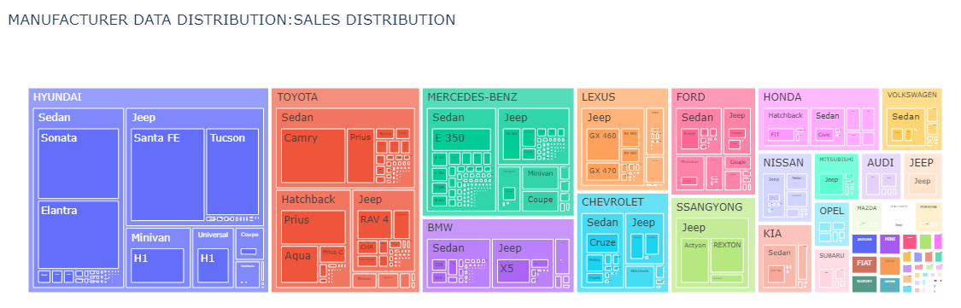
Data Exploration
Which manufacturer is the most successful?

Slide 9
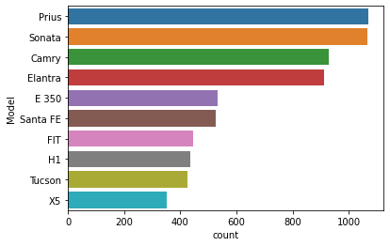
Data Exploration
What is Most Preferred Model?
Prius and Sonata are Common in Car Market.

Slide 10
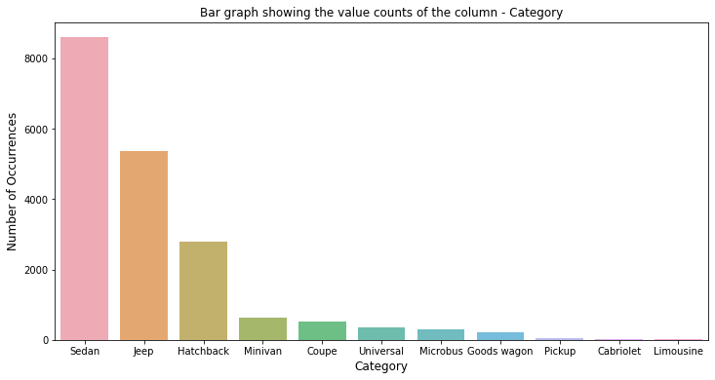
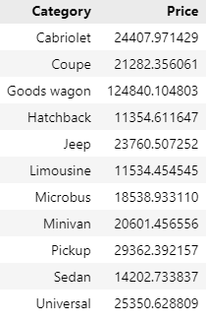
Data Exploration
Which Category consider a best choice for a User to choose?
Mean prices of category
Sedan can be great choice as its high existence and low mean price.

Slide 11
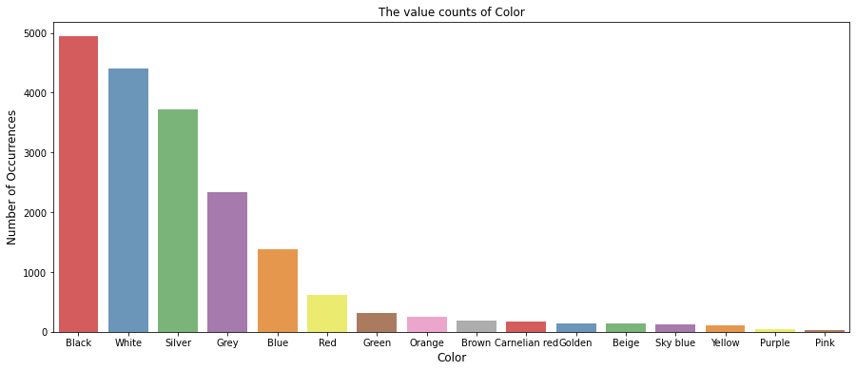
Data Exploration
What is the most used color?
Black and white make up the half of the values.

Slide 12
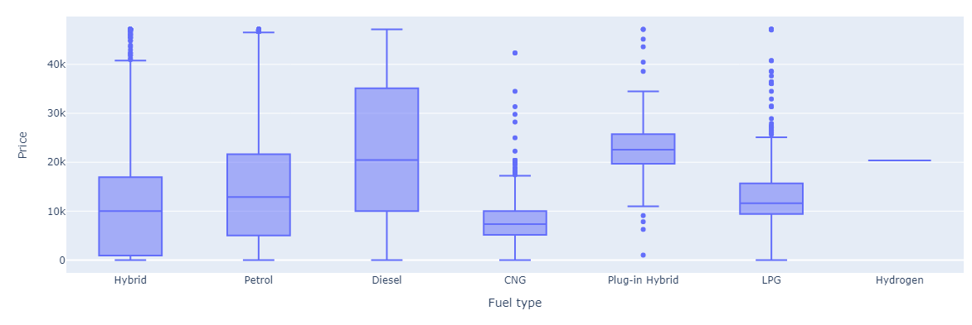
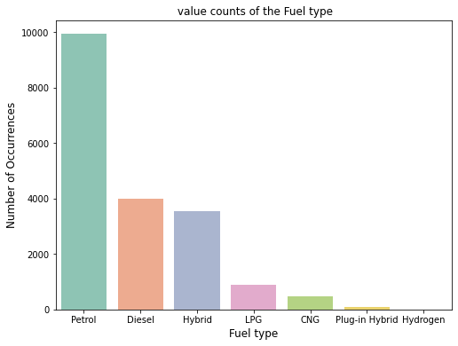
Data Exploration
Suitable fuel type?
Hybrid has good avg. prices with medium occurrences.
Petrol is the most common with suitable mean price range.

Slide 13
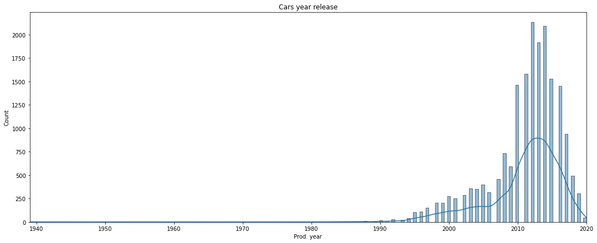
Data Exploration
Do the technology helped in the manufacturing of cars?
How did the Plunging sales affected the increase of manufacturing in the recent years?

Slide 14
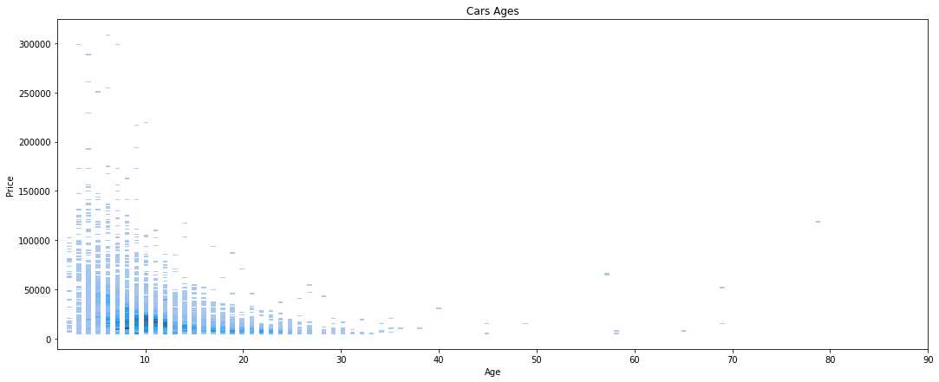
Data Exploration
The affect of the car age to the price?
As the car gets older the price quickly decreases.

Slide 15
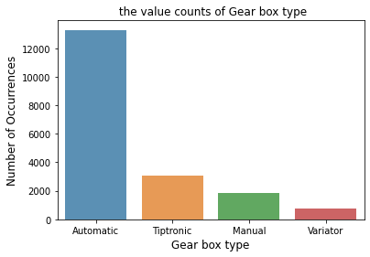
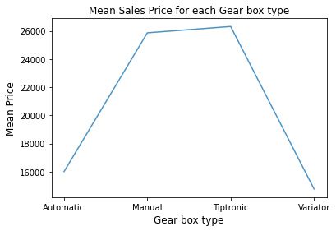
Data Exploration
Suitable Gear box?
Absolutely the Automatic vehicles.

Slide 16
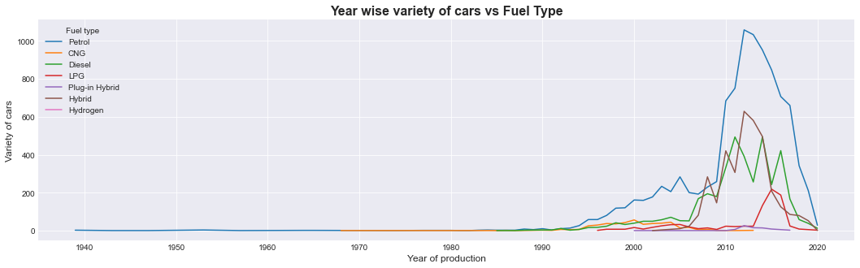
Data Exploration

Slide 17
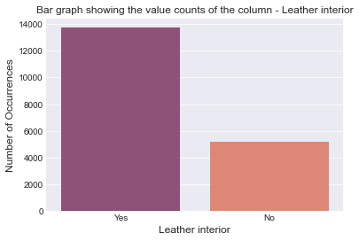
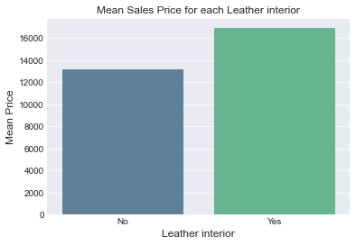
Data Exploration
Suitable Leather interior ?

Slide 18

Data Pre-Processing
Dataset problems:
Duplicates values
Some numeric features is saved as object type
Some columns are skewed.
Some columns have noisy data.
Cleaning data without spoiling the realistic of the data.
Outliers causes big problems.
Models have low accuracy score.

Slide 19
Data Pre-Processing
Handling the dataset problems feature by feature:
ID:
Solved the duplicated problem by dropping them off .
Levy:
Change the – symbol with 0 as it means that’s the car has no fine. (changed to numeric feature)
Engine volume:
Make a new feature (engine turbo) that determines whether the engine is turbo or not. (increased the model accuracy)
Dropped the word turbo from the feature. (changed to numeric feature)

Slide 20
Data Pre-Processing
Handling the dataset problems feature by feature:
Mileage:
Dropped the word km from the values. (changed to numeric feature)
Doors:
Dropped the unnecessary words to appear as no. of doors feature in the car. (cleaning)

Slide 21
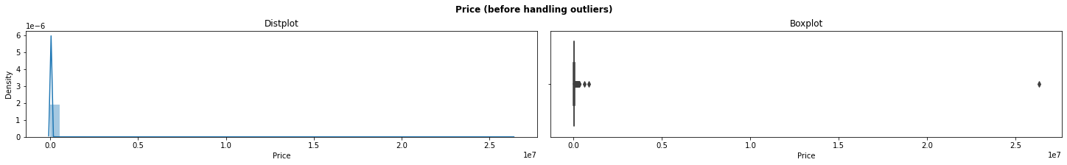
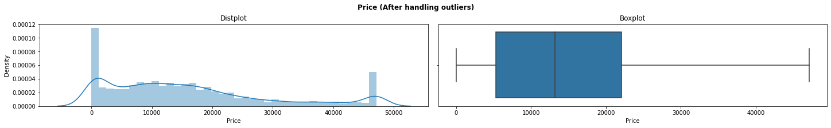
Data Pre-Processing
Handling the dataset problems feature by feature:
Price:
Dropped the outliers with IQR. (Handled the outliers and the skew)

Slide 22
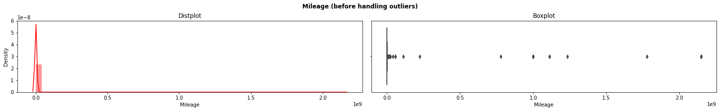
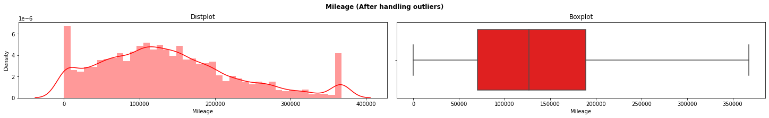
Data Pre-Processing
Handling the dataset problems feature by feature:
Mileage:
Dropped the outliers with IQR. (Handled the outliers and the skew)

Slide 23
Data Modeling
Linear Regression
KNeighborsRegressor
Gradient Boosting Regressor
Random Forest Regressor
XGboost

Slide 24

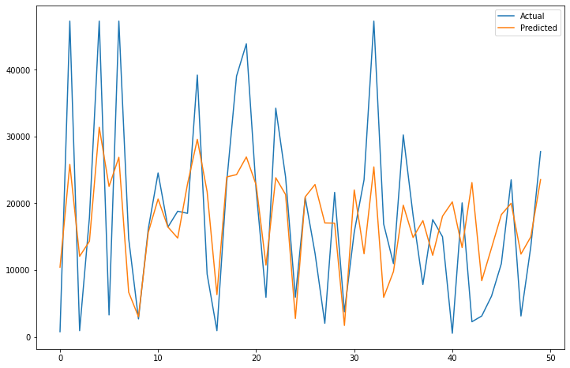
Linear Regression

Slide 25

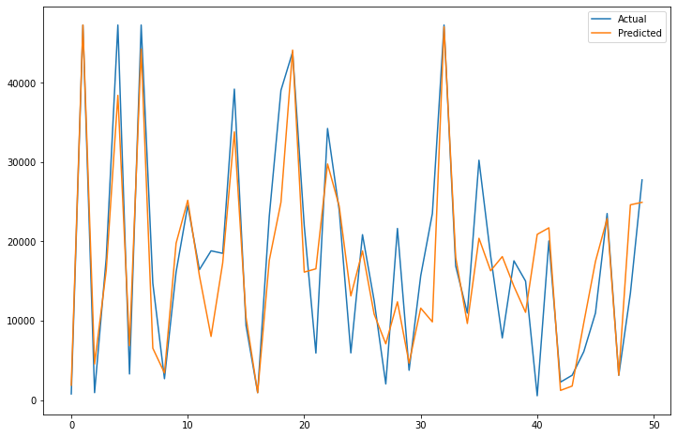
KNeighborsRegressor

Slide 26

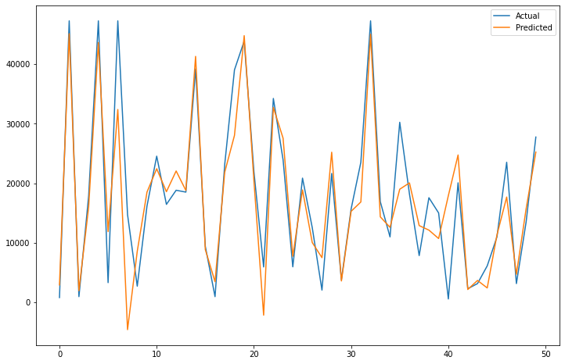
Gradient Boosting Regressor

Slide 27

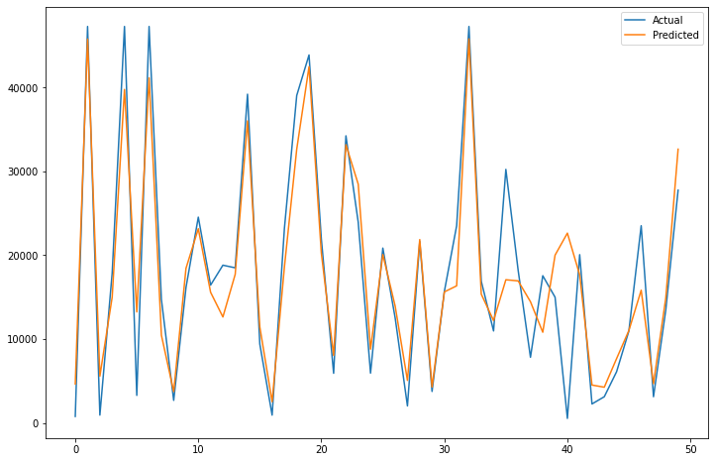
Random Forest Regressor

Slide 28

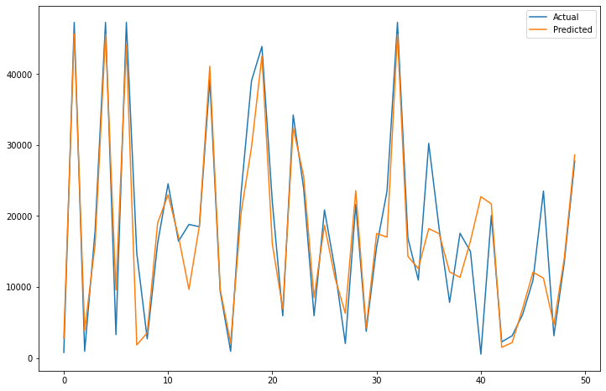
XGboost

Slide 29
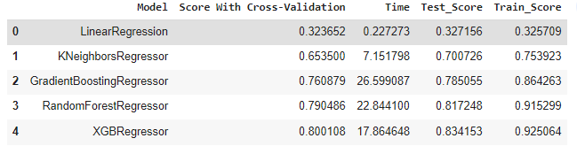
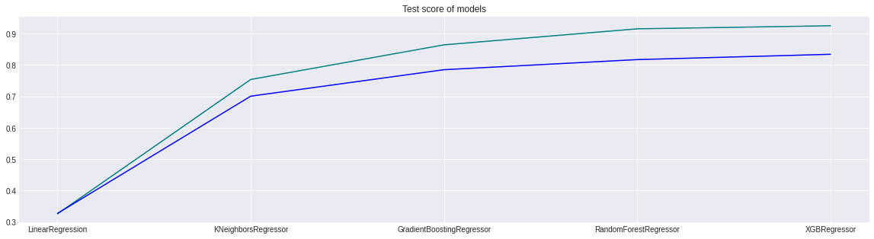
Summary

Slide 30
Recommendations for buyers
Sedan Category will be a fair choice due to its low mean prices.
Recommend old cars due to its low mean prices.
Hybrid Fuel cars will take over the petrol in the next years due to its low mean prices.
Not recommended cars with Tiptronic gearbox due to its High mean prices.
Not recommended cars with Leather interior due to its High mean prices.
Different types of Drive wheels have similar mean prices.

Slide 31

THANK YOU

